Slide 1
CSCI 1101 Introduction to Computer Science
Arithmetic in non-decimal bases
And
Representing Integer values

Slide 2
Arithmetic in Binary
Remember that there are only 2 digits in binary, 0 and 1
Carry Values
 |  |  | 1 | 1 | 1 | 1 | 1
 |  | 1 | 0 | 1 | 0 | 1 | 1 | 1
+ |  | 1 | 0 | 0 | 1 | 0 | 1 | 1
 | 1 | 0 | 1 | 0 | 0 | 0 | 1 | 0*
*: 1+1 = 2
No digit for 2 in Binary. So 2-2=0 and a carry

Slide 3
Subtracting Binary Numbers
Remember borrowing? Apply that concept here:
 |  | 1⁰ | 0⁻¹² | 1⁰² | 0² | 1 | 1 | 1
- |  |  | 1 | 1 | 1 | 0 | 1 | 1
 |  | 0 | 0 | 1 | 1 | 1 | 0 | 0
If minuend < subtrahend borrow 2 from immediate left column and subtract 1 from value in that column.

Slide 4
Same idea, different base (hex)
Addition
Subtraction
 |  | 1
 |  | A | 3
+ |  | 1 | E
 |  | C | 1*
 |  | A⁹ | 3¹⁶
- |  | 1 | E
 |  | 8 | 5
*: 3+E = 3+14=17
No digit for 17 in Hex
So 17-16=1 and a carry
If minuend < subtrahend borrow 16 from immediate left column and subtract 1 from value in that column.

Slide 5
Analog and Digital Information
Computers are finite!
How do we represent an infinite world?
We represent enough of the world to satisfy our computational needs and our senses of sight and sound

Slide 6
Bits and Bit Patterns
Bit: Binary Digit (0 or 1)
Bit Patterns are used to represent information.
Numbers
Text characters
Images
Sound
And others

Slide 7
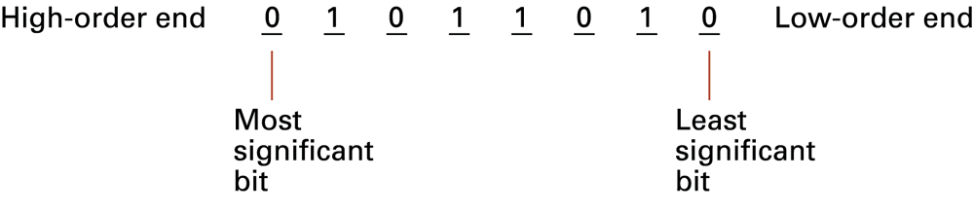
Main Memory Cells
Cell: A unit of main memory (typically 8 bits which is one byte)
Most significant bit: the bit at the left (high-order) end of the conceptual row of bits in a memory cell
Least significant bit: the bit at the right (low-order) end of the conceptual row of bits in a memory cell

Slide 8
Binary Representations
One bit can be either 0 or 1
One bit can represent two things (Why?)
Two bits can represent four things (Why?)
How many things can three bits represent?
How many things can four bits represent?
How many things can eight bits represent?

Slide 9
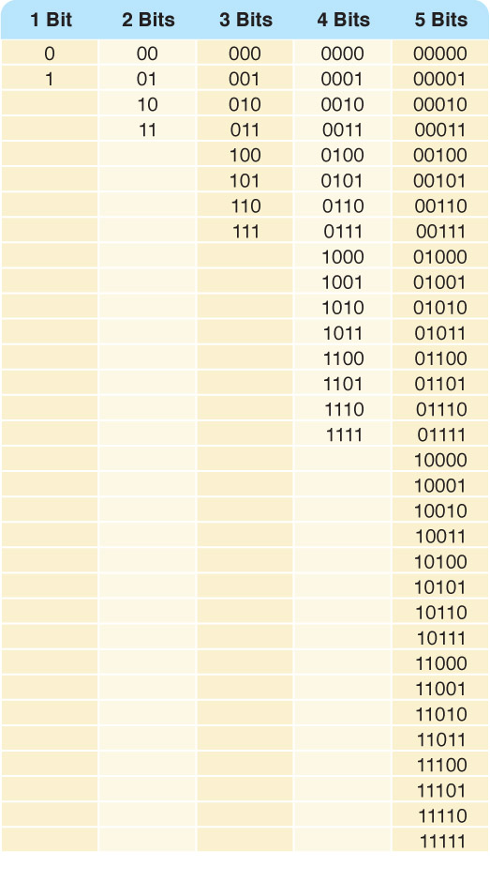
Binary Representations
Counting with
binary bits

Slide 10
Binary Representations
How many things can η bits represent?
Why?
What happens every time you increase the number of bits by one?

Slide 11
Representing Numeric Data
Quick Note:
Integers and floating-point (real) numbers are different
These kinds of values are represented differently in computers.
Integers first…

Slide 12
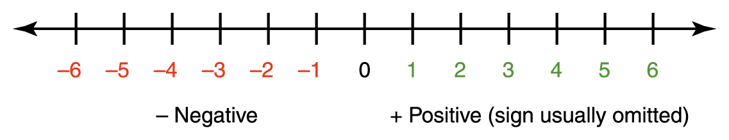
Representing Negative Values
Signed-magnitude number representation
The sign represents the ordering, and the digits represent the magnitude of the number.
This is what we use for decimal numbers.

Slide 13
Representing Negative Values
There is a problem with the sign-magnitude representation: every number should have a positive and a negative representation and so there is a plus zero and minus zero
We make an exception with the zero and ignore the minus zero but this causes unnecessary complexity to the hardware of a computer
Solution:
Keep all numbers as integer values, with half of them representing negative numbers. Here’s how…

Slide 14
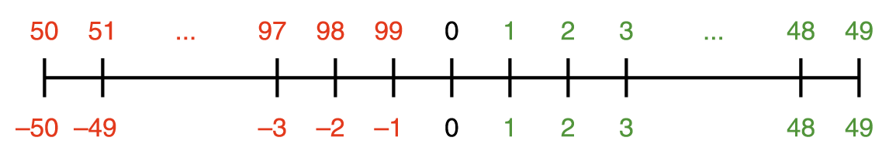
Representing Negative Values
First, think about it using decimal numbers.
Using two decimal digits
let 1 through 49 represent 1 through 49 (positive values)
let 50 through 99 represent -50 through -1 (negative values)
This representation is known as 10’s complement.
Notice that only negative numbers have a “different” representation in both systems (signed magnitude and 10’s complement).

Slide 15
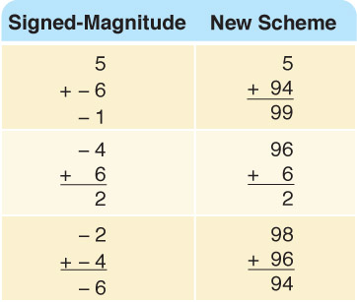
Representing Negative Values
To perform addition, add the numbers and discard any carry
Now you try it
48 (signed-magnitude)
1
47
How does it work in
the new scheme?

Slide 16
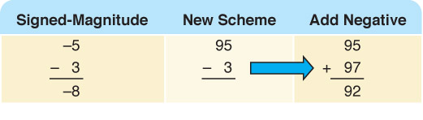
Representing Negative Values
A-B=A+(-B)
Add the negative of the second to the first
Try
4 - 4 -4
- 3 +3 + -3

Slide 17
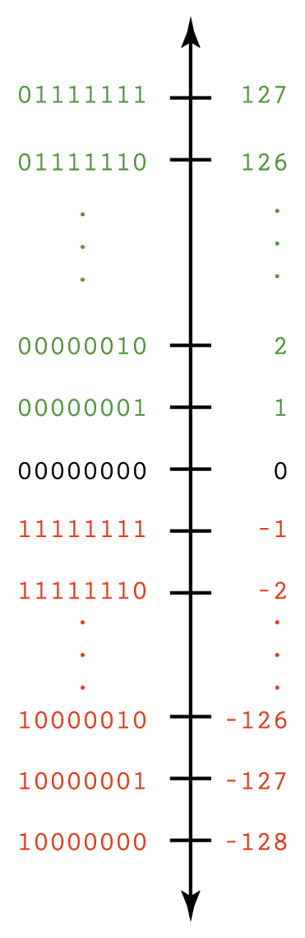
Representing Negative Values
Now for binary
Two’s Complement (Vertical line is easier to read)
Notice that all positive numbers have a zero in the most significant bit while all negative numbers have a one in the most significant bit (this is a quick way to determine if a number is positive or negative in the 2’s complement representation)

Slide 18
Finding the Two’s complement representation
IMPORTANT: The idea of the representation and the algorithm (procedure) for finding the representation are distinct from each other!
Positive values are simply the “regular” binary
To find the two’s complement representation of a negative number:
Flip the bits of the positive binary of the magnitude
Add 1
Or use this alternative method:
http://www.youtube.com/watch?v=zWWWZJ_w2CA

Slide 19
Representing Negative Values
Addition and subtraction are the same as in 10’s complement arithmetic
-127 10000001
+ 1 00000001
-126 10000010
Notice the left-most bit is a one (1) indicating a negative number.

Slide 20
Number Overflow
What happens if the computed value won't fit?
Overflow Watch this video for a nice explanation:
http://www.youtube.com/watch?v=rnQwucEfT6A
If each value is stored using 8 bits, adding 127 to 3 overflows
Problems occur when mapping an infinite world onto a finite machine!
 | 1 | 1 | 1 | 1 | 1 | 1 | 1
 | 0 | 1 | 1 | 1 | 1 | 1 | 1 | 1
+ | 0 | 0 | 0 | 0 | 0 | 0 | 1 | 1
 | 1 | 0 | 0 | 0 | 0 | 0 | 1 | 0

Slide 21
Number Overflow
Important things to remember when adding numbers in 2’s complement notation to determine if there is overflow:
You must know the length of the number (number of bits)
You must disregard any bit you may get as a carry on the leftmost column (most significant bit)
If the result of adding 2 positive numbers is negative or the result of adding 2 negative numbers is positive then there is OVERFLOW
Adding a negative to a positive number or vice versa will never produce an overflow because they tend to cancel each other
None of the examples below produce overflow:
1 | 1 | 0 | 0 | 0 | 0 | 0 | 0
 | 0 | 1 | 0 | 0 | 1 | 0 | 0 | 1
+ | 1 | 1 | 1 | 1 | 0 | 1 | 0 | 0
1 | 0 | 0 | 1 | 1 | 1 | 1 | 0 | 1
1 | 1 | 0 | 1 | 1 | 1 | 0 | 1
 | 1 | 1 | 0 | 0 | 0 | 1 | 0 | 1
+ | 1 | 1 | 0 | 1 | 1 | 1 | 0 | 1
1 | 1 | 0 | 1 | 0 | 0 | 0 | 1 | 0
No overflow!!!

Slide 22
Representing Real Numbers
Real numbers in the decimal system
A number with a whole part and a fractional part
104.32, 0.999999, 357.0, and 3.14159
Weights (place values) to the right of the decimal point have negative exponents and the base is 10:
10⁻¹, 10⁻² , 10⁻³ , 10⁻⁴, …

Slide 23
Representing Real Numbers
Real numbers in the binary system
A number with a whole part and a fractional part
10.101, 0.11101, 1011.1, and 11.111
Weights (place values) to the right of the radix point have negative exponents and the base is 2:
2⁻¹, 2⁻², 2⁻³, 2⁻⁴, …

Slide 24
Converting binary fractions to decimal fractions
Multiply each fractional bit by 2 raised to the corresponding power
Solve the sum
Example
(0.101)₂ = ( )₁₀
1 * 2⁻¹ + 0 * 2⁻² + 1 * 2⁻³
^{This is equivalent to}
1 * (1/2) + 0 * (1/4) + 1 * (1/8) = .625
Thus: 0.101 = 0.625

Slide 25
Converting decimal fractions to binary fractions
Multiply the fraction by 2
The whole part is the binary digit
Take the fractional part and repeat the steps above until the fractional part is zero or you have enough binary digits
Example
(0.832)₁₀ = ( )₂
.832 * 2 = 1.664 => 1
.664 * 2 = 1.328 => 1
.328 * 2 = 0.656 => 0
.656 * 2 = 1.312 => 1
Thus, (0.832)₁₀ ≈ (0.1101)₂

Slide 26
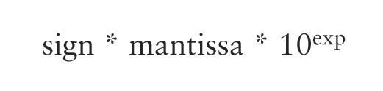
Representing Real Numbers
A real value in base 10 can be defined by the following formula
The representation is called floating point because the number of digits is fixed but the radix point floats

Slide 27
Storing Real Numbers
A binary representation has to account for all the “parts” of the floating point representation
Sign: 0 to indicate positive, 1 to indicate negative
Mantissa: the bits that result from normalizing the number (the radix point is moved to the left of the leftmost 1 in the number)
Exponent: indicates the number of positions the radix point needs to be moved to the right (if the exponent is positive) or to the left (if the exponent is negative) to go back to its original location
Sign Exponent Mantissa

Slide 28
Storing Real Numbers
Example: (2.625)₁₀ = (10.101)₂
Normalized mantissa = .10101 This digit is lost
Exponent = 010 (+2 in base 10)
1
What if there isn’t enough room for some part of the representation (notably the mantissa)?
Truncation error, aka floating-point error.
0 | 0 | 1 | 0 | 1 | 0 | 1 | 0
Sign Exponent Mantissa

Slide 29
Real world example
Microsoft Visual C++ is consistent with the IEEE numeric standards: it stores real numbers according to the table shown below.
Value | Stored as
Float | sign bit, 8-bit exponent, 23-bit mantissa
Double | sign bit, 11-bit exponent, 52-bit mantissa

